Slide 1
Assessing the effectiveness of a food delivery company’s Referral scheme
By Farshad rastgouy

Slide 2
Context & Objectives
We are given data on the referral scheme for riders of a food delivery company
We want to understand:
How has the referral scheme performed, especially against other channels?
Has the referral scheme been successful?
Are there any important factors to consider for changes to the scheme?

Slide 3
How can we define success for the referral scheme?
Acquisition volume
Availability of riders
Retention rate of riders
Secondary referrals from riders
Demand met by riders
Efficiency of demand met from riders
Uptake rate of riders
Quality of riders
ROI on riders
Supply gap plugging of riders

Slide 4
Data fields available
Categorical data:
City of Riders
Vehicle Used
Days since Acquisition
When the riders:
Applied
Were approved
Started working
Metrics to work with:
Hours worked
Orders delivered
Throughput
Referral Count
Successful Referral Count
Count of riders

Slide 5
How can we define success for the referral scheme with the data available?
Acquisition volume
Count of riders
Availability of riders
Hours worked by riders
Retention rate of riders
Inactivity rate of riders
Successful referrals from riders
Counts of successful riders
Demand met by riders
Orders delivered by riders
Efficiency of demand met from riders
Throughput

Slide 6
How can we define success for the referral scheme that we do not have data available for?
Quality of riders
Rider rating
Rider feedback
Rider speed/unit congestion
On-time delivery rate
On-time delivery discrepancy
ROI on riders
Referral cost/operational profit rate
Supply gap plugging of riders
Orders delivered/unit demand

Slide 7
Data considerations
Data has tells us what is happening after 1 week, 2 weeks, 4 weeks, 8 weeks, 12 weeks and 24 weeks
We can tell how the metrics available change:
Over time
Across different cities:
3 different cities
Cape Town has by far the least (324 riders), but its sufficient for analysis
Across different vehicle types:
Only Bicycle and Scooter/Motorbikes have ample data for meaningful analysis
Electric bikes, Motor Vehicles and Pedestrian/Walkers are grouped up as “Other”

Slide 8
Data considerations
Normalised metrics are standardised for each combination of city and vehicles that have enough data (largest excluded combination is Cape Town, Motor Vehicle which has 48 riders):
Rio de Janeiro, Bike
Cape Town, Bike
New York, Bike
New York, Scooter/Motorbike
Normalised values have 0 as the minimum, 1 is the 99th percentile value
The only channel that loses a relevant proportion of riders is the Unknown channel – loses 9% of riders with a loss of 10 rider
Loses 90 riders in total (1.7% of riders)
Useful alongside normal totals to see if numbers are being skewed by compositional imbalance between the hours worked, orders delivered, etc across different vehicle types in different location
Using a bike in Cape Town may mean being able to work or deliver different amounts than say using a scooter in New York

Slide 9
Edge cases
Riders are included if they have either:
Worked 7 hours within 24 weeks of acquisition
bottom 8% of all riders have worked less hours
Retains the top 3% of riders who have made 0 orders, in terms of hours worked
Made 7 Orders within 24 weeks of acquisition
bottom 7% of all riders have delivered less orders
Retains 30% of riders who have worked below the hours worked threshold of 7 hours
Riders that cannot fulfil either criterion make up 5.5% of all riders

Slide 10
Edge cases
Values are capped at the top 0.5% of riders for the following metrics to avoid skewing averages:
Hours worked
Orders delivered
Throughput
Successful referrals
0.5% was chosen by plotting the quartile values of these metrics to see when the biggest spikes were occurring
This way the numbers that are way bigger, the top 0.5% are included in the data but not skewing averages as much

Slide 11
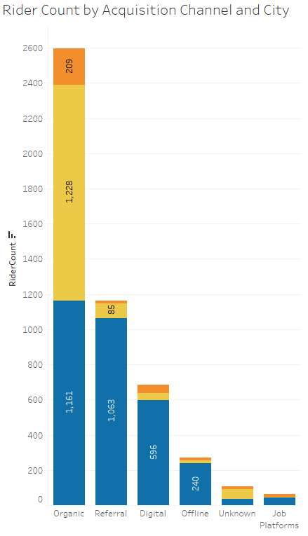

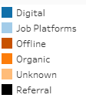
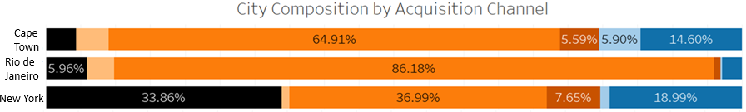
Acquisition volume
We can see that referrals are second to only organically acquired riders
New York is where the referral scheme has really taken off, making up the bulk of riders referred
Referrals still makes up the second biggest source of riders in Rio de Janeiro, but haven’t substantially contributed to the city’s source of riders
Referrals make up the smallest source of riders in Cape Town

Slide 12
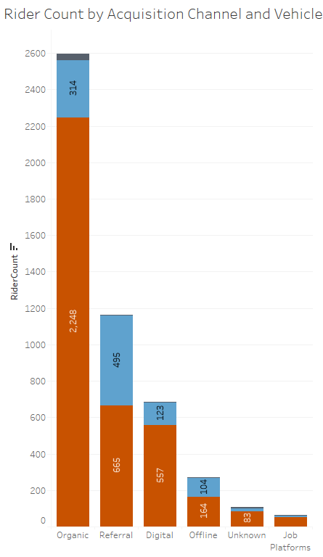

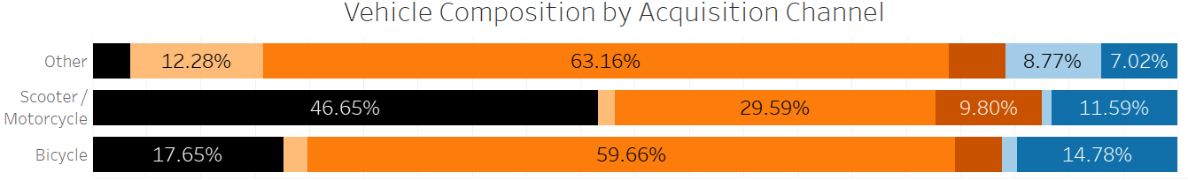
Acquisition volume
Referrals are entirely Bikes and Scooters bar 2 riders, with Bikes making up the biggest share
Scooters make up a biggest proportion of referrals compared to other channels though
Referrals make up the second biggest source of riders using a bike

Slide 13
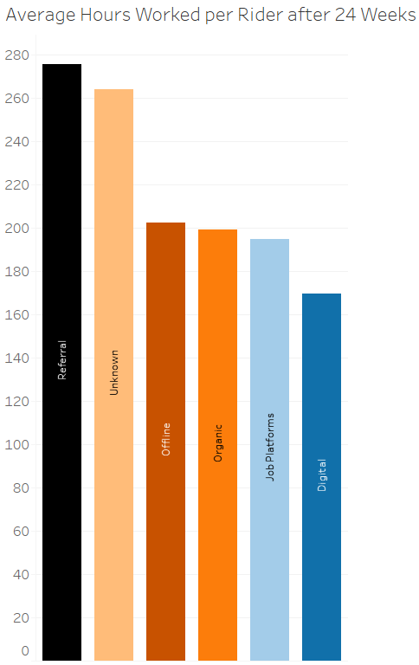
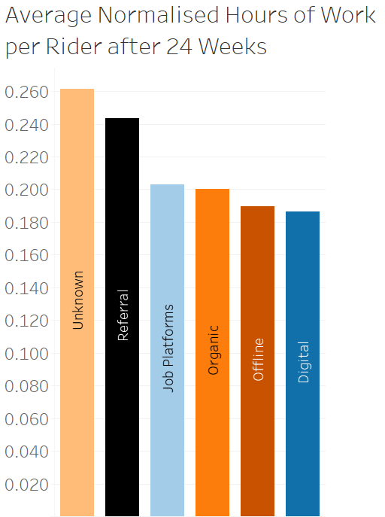
availability
Riders that were referred are at the upper end of availability
They do the most number of hours of work on average
Only just losing out to Unknown channels when normalised by vehicle and city combinations
Albeit Unknown channels have far less riders so the data is more sensitive are less reliable

Slide 14
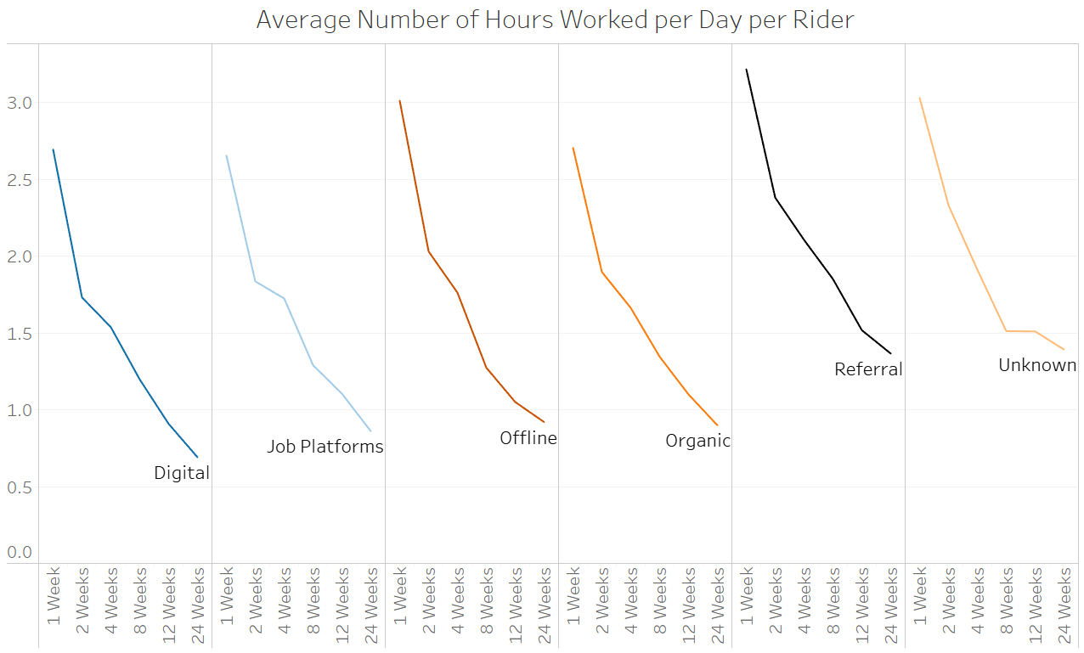
availability
We see a similar decline in the average hours worked a day per rider across different channels
Referred riders initially work the most per day in the 1st week
Within 24 weeks they are the joint top in terms of hours worked along with riders from Unknown channels

Slide 15
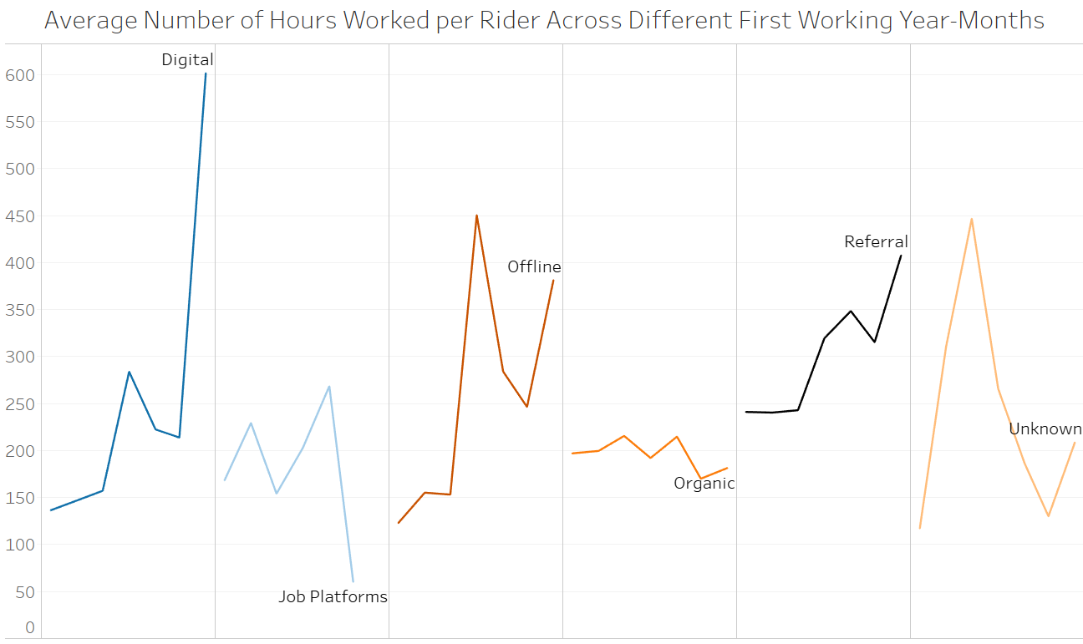
availability
We can see that the availability of riders acquired under referral is increasing for new riders over the months
Average number of hours worked per rider increases for later First Working Year-Months
We see a similar general trend across other channels as well though, so referrals are not necessarily doing better than other channels (like Digital and Offline)
But it is still increasing, unlike other channels (like Organic)
Started off with the most availability, but flatlines until jumping up in January 2017

Slide 16
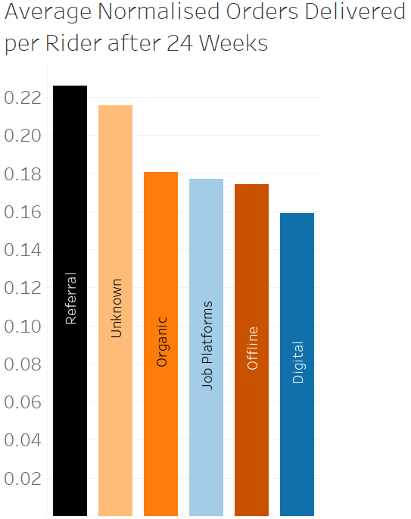
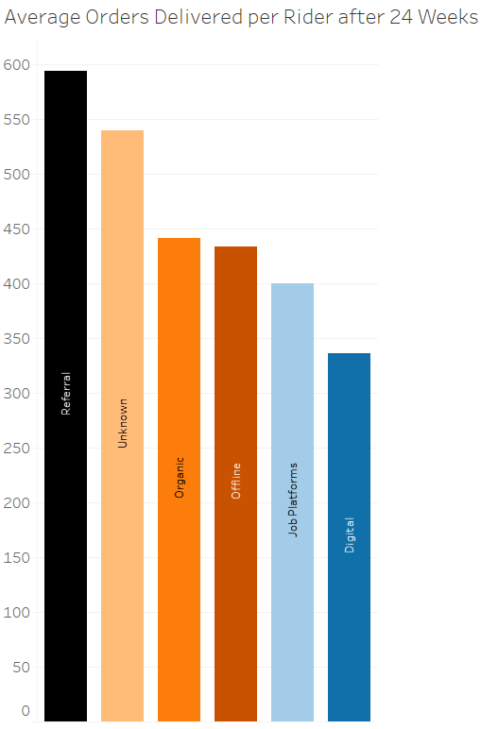
Demand met
Riders that were referred meet the most demand per head
They deliver the most orders on average
This is also the case when normalised for city and vehicle combinations

Slide 17
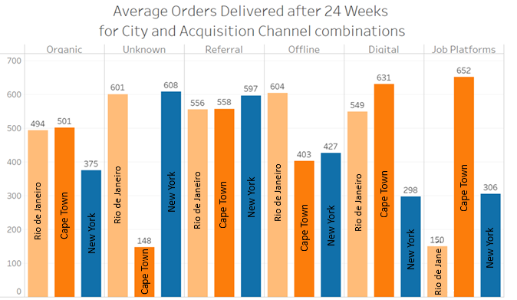
Demand met
From this we can see that riders acquired through referrals are consistently strong at meeting demands across all cities
While riders acquired through referrals may not be #1 in each city individually, but they consistently perform strongly to meet demands
Other channels (like Digital for example) do very well in one city and not well at all in another city

Slide 18
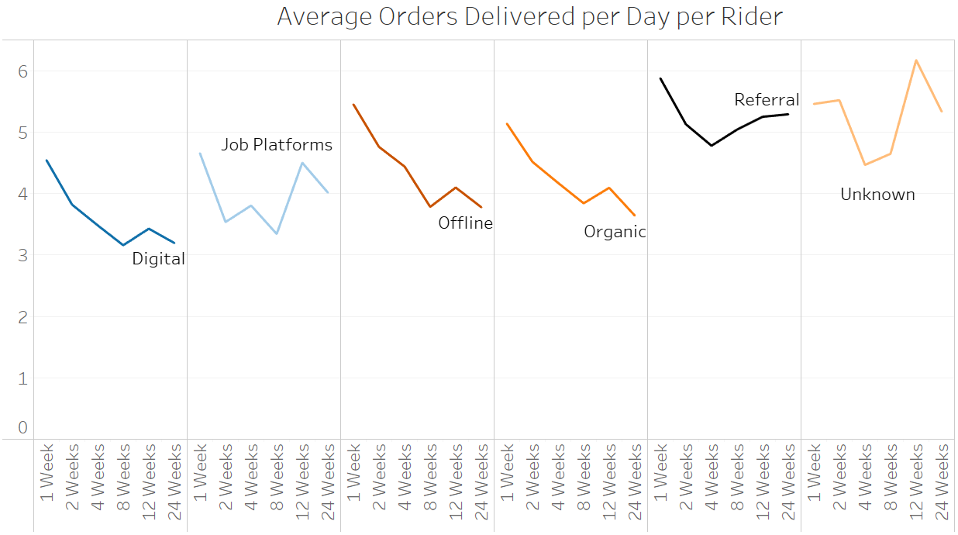
Demand met
We can see that the average rider has its average orders delivered per day decreasing until 4 weeks after acquisition, then it increases
This is different to Digital, Offline and Organic who all see steady declines
This means referred riders on average sustain the rate at which they meet demand on an ordinary day better than other channels
Unknown and Job Platforms also see a lift, but these channels have less data and so their data is more sensitive and less reliable

Slide 19
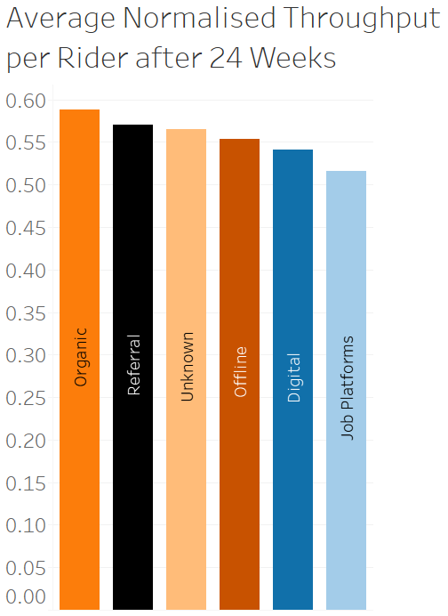
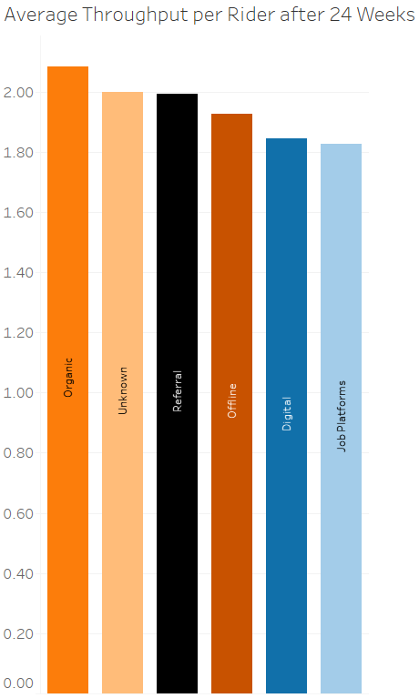
Efficiency of Demand met
Riders that were referred are some of the most efficient at meeting demand
They register on average the 3rd highest throughput per rider, but just shy of rider coming from unknown channels and only slightly below the acquisition with the most average Throughput per rider (Organic) by 0.09
When normalised for city and vehicle combinations however, they perform even better and take 2nd spot

Slide 20
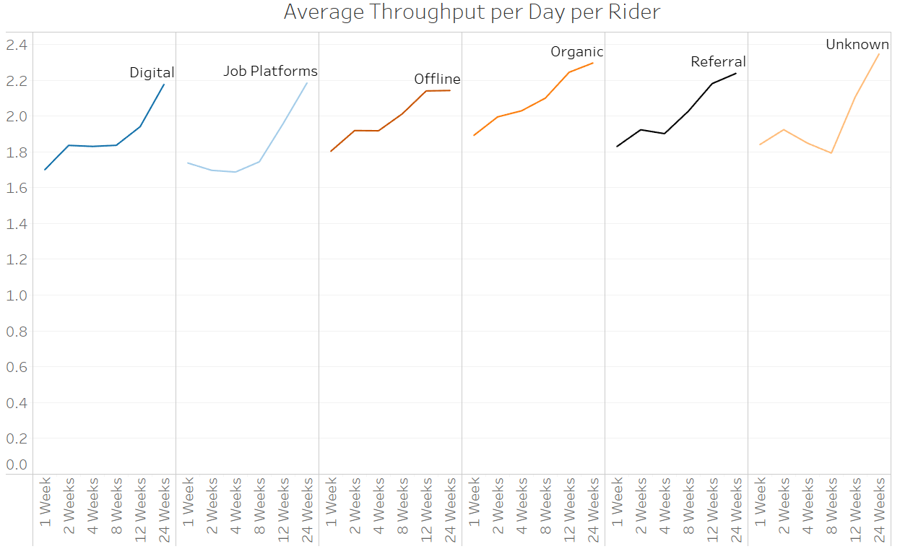
Efficiency of Demand met
We can see a general trend where throughput improves over time as riders get more experienced in the role
This is true across all channels, including Referrals

Slide 21
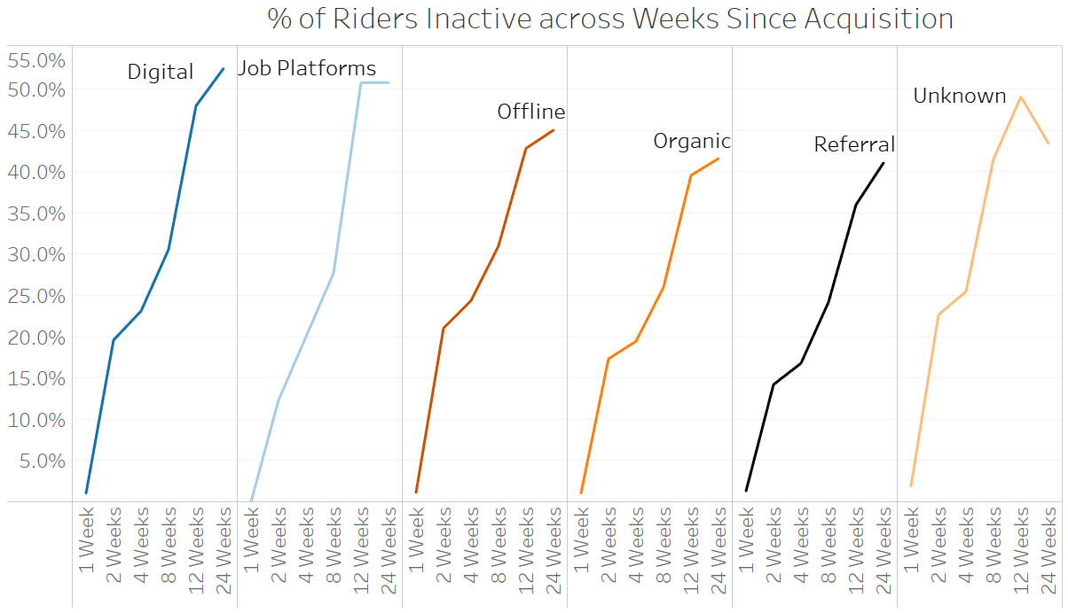
Retention rates
Riders acquired through referrals have some of the best retention across all channels, with the lowest amount of inactive riders after 24 weeks – 41%
All channels see a rise in riders inactivity over time ranging from 41% to 53% (Digital)

Slide 22
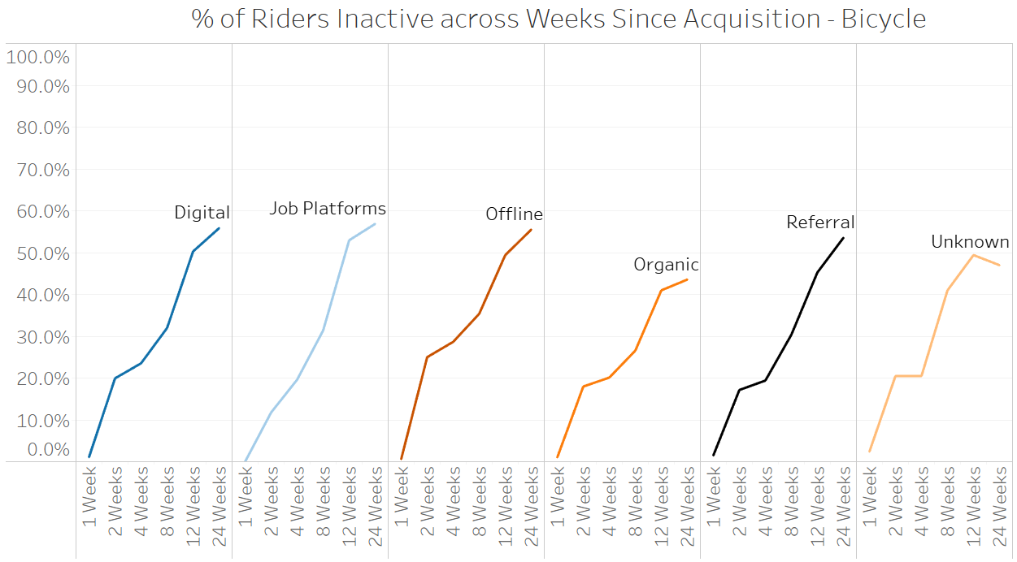
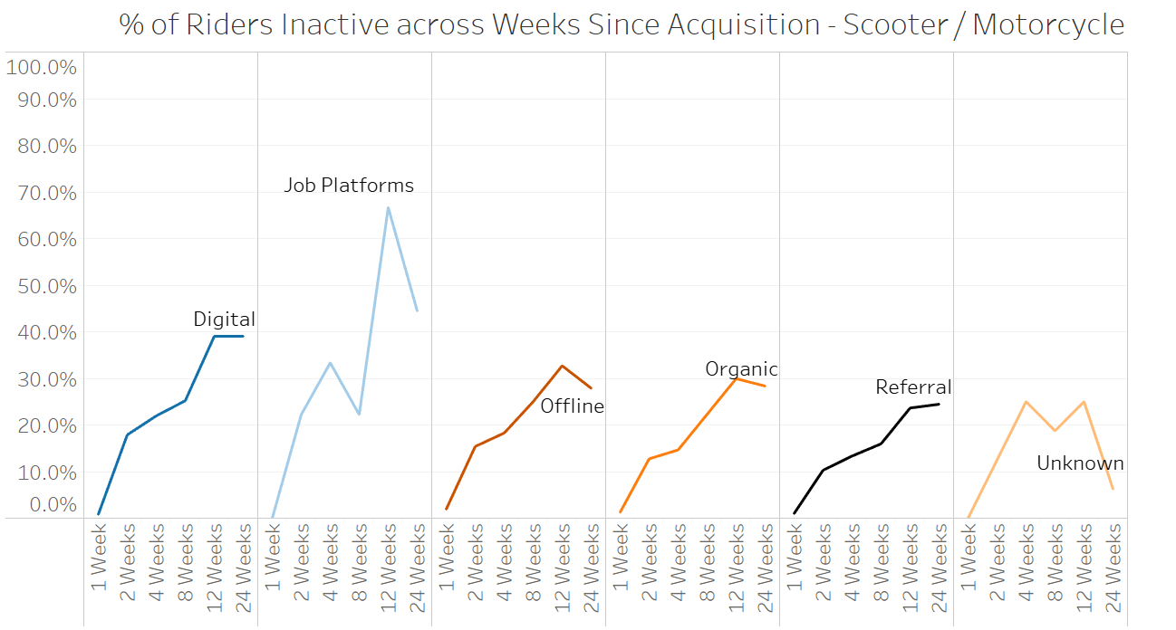
Retention rates
We can see the % of referred riders being inactive is in line with other channels for Bikes
Referral - 54% inactive after 24 weeks
Offline – 56% inactive after 24 weeks
Digital – 56% inactive after 24 weeks
The % of referred riders being inactive for Scooters/Motorbikes is significantly smaller than other channels however – 24% inactive after 24 weeks

Slide 23
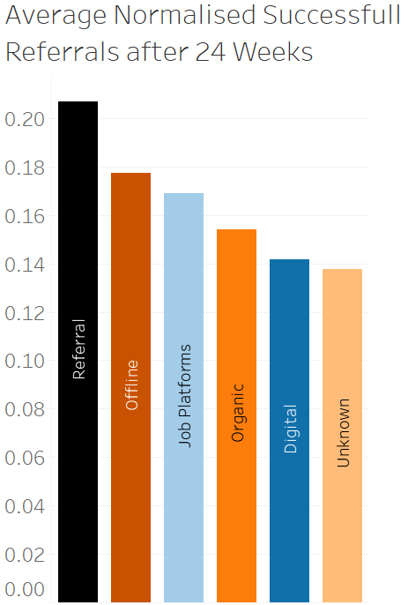
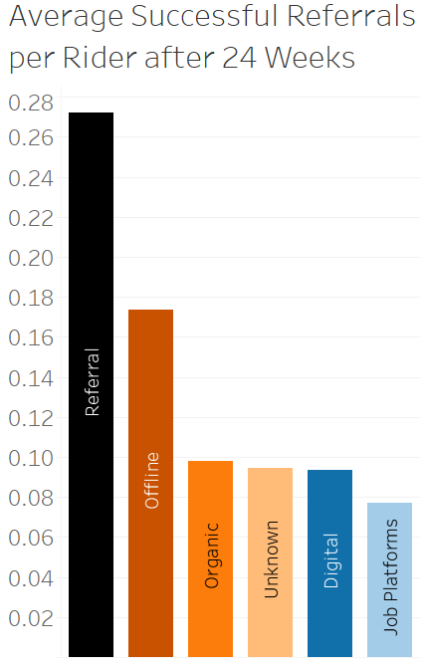
Successful referrals
Riders acquired through referrals have by far the highest rate of successfully referring other riders on average 0.27 successful referrals in 24 weeks
The next best is riders acquired offline with on average 0.17 successful referrals in 24 weeks
The gap is smaller when normalising for vehicle and city combinations however
Referrals – 0.21
Offline – 0.18

Slide 24
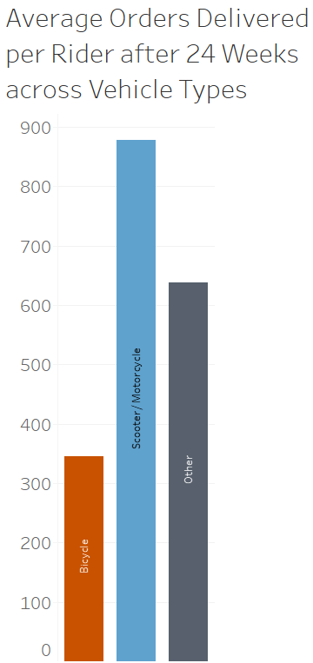
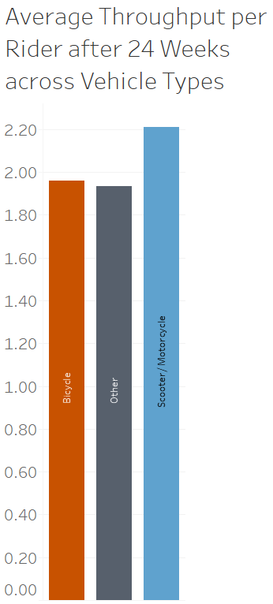
Other analysis
As we can see scooter/motorbikes are the most efficient at meeting demand and meet the most demand per rider
Unsurprising, given that they are the only Vehicle Type that is entirely motorised
In a separate analysis we see that uptake is always just shy of 100% with minimal differences across many categories

Slide 25
Overall assessment
The referral scheme is the 2nd biggest source of riders, driven heavily by riders in New York
The referral scheme is still Roo da Janeiro’s second biggest source of riders
The referral scheme contributes to under half of scooter/motorbike riders – these naturally have higher throughput than bikes
Referred riders are the most available given that they put in the most hours on average compared to other channels
Referred riders meet the most demand per head compared to other channels
Referred riders are the 2nd most efficient at meeting demand when normalising data for vehicle and city combinations
Referred riders have the best retention and have especially good retention for scooter/motorbikes
Referred riders are also the most likely to successfully refer another rider as well – effectively inducing a “snowball” effect for our fleet

Slide 26
Has rgr been a success?
The referral scheme consistently performed well across all metrics of success analysed by either exceeding or keeping up with the other well performing channels
It already pulls in a good chunk of our current fleet with the second highest acquisition volume
It is our best source of individual service for availability and the meeting of demand, and these riders stick around the longest
In addition, they are the most effective at successfully referring other riders – creating a “snow ball” effect for our fleet
Therefore based on the analysis conducted with the data we have, I would call it a success so far, but more so in New York and for Scooter/Rider riders than anywhere else

Slide 27
Should we change anything?
The referral scheme is more successful in New York and Scooters/Motorbikes than Cape Town, Rio de Janeiro and Bikes:
Explore this further to determine why the referral scheme is not as successful here
Investigate local conditions (e.g., demand, rider incentives, marketing) to understand why the referral scheme underperforms
Investigate what makes referrals a success in New York and Scooters/Motorbikes and compare that across
If the underlying issues can be addressed, replicate the referral scheme’s success from New York and Motorbikes/Scooters in Rio de Janeiro and Cape Town, and with Bicycles

Slide 28
Should we change anything?
Retention rates and throughput for scooters/motorbikes are much better, so we could either:
Double down on this success—offer targeted incentives or campaigns to bring more scooter/motorbike riders through the referral scheme
Or look to address the retention of bikes, by exploring reasons why bike riders leave earlier, then adjust the referral incentive or onboarding process
The referral scheme brings in good riders, but it’s not bringing in many riders in Rio de Janeiro and Cape Town compared to New York
Focus on enhancing the referral scheme in Rio de Janeiro and Cape Town to break into these cities better
Referred riders successfully refer the most riders, so try targeted referral incentives to those referred to enhance the “snow ball” effect

Slide 29
What to do next
Obtain more data to do a more rigorous analysis of success and get a better sense at how the referral scheme is effective in these regards:
Quality of riders
Rider rating
Rider feedback
Potentially some sentiment analysis
Rider speed/unit congestion
Need to get hold of traffic congestion data for this
On-time delivery rate
On-time delivery discrepancy

Slide 30
What to do next
Obtain more data to do a more rigorous analysis of success and get a better sense at how the referral scheme is effective in these regards:
ROI on riders
Referral cost/operational profit rate
Data for cost of referral
Data for associated operational cost and revenue associated to each order and rider
Supply gap plugging of riders
Orders delivered/unit demand
Need a way of predicting/estimating demand
Demand at different time and locations

Slide 31
What to do next
Identify where “super riders” (top 1% of riders across metrics of success) are and how we can acquire them
Are referrals good at acquiring super riders?
Investigate the Unknown acquisition channel to better understand where these riders are coming from

Slide 32
Conclusion
From the data we have available, the referral scheme looks like it’s been a success overall, particularly in New York and for scooter/motorbike riders
At this point we could:
Explore why it hasn’t been as successful in Rio de Janeiro, Cape Town and Bicycles to replicate the referral scheme’s success in New York and with scooters/motorbikes
Targeted referral incentive for scooter riders and those acquired via referrals
Attain more data to explore the other measures of success such as:
Quality of riders
ROI of riders
Supply gap plugging of riders
Investigate where the “Unknown” acquisition channel is bringing in riders from

